Slide 1
Assignment #3 - Gestures
Chess
Fábio Nunes 80321 Tiago Correia 80378

Slide 2
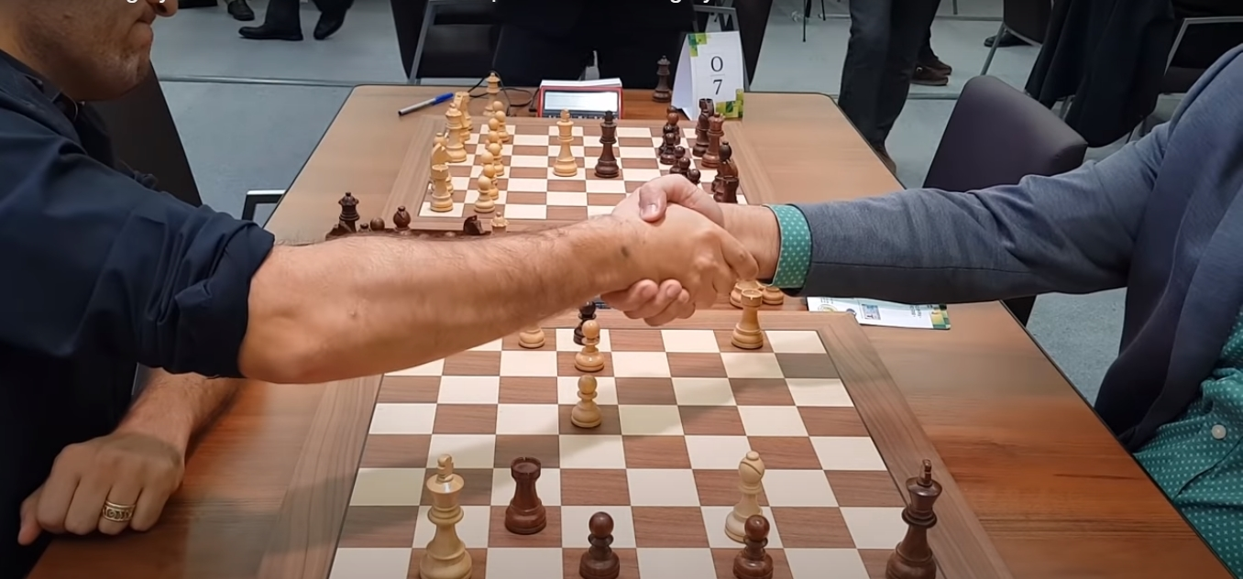
Draw
- One player makes the offer
- The other either accepts or refuses

Slide 3
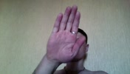

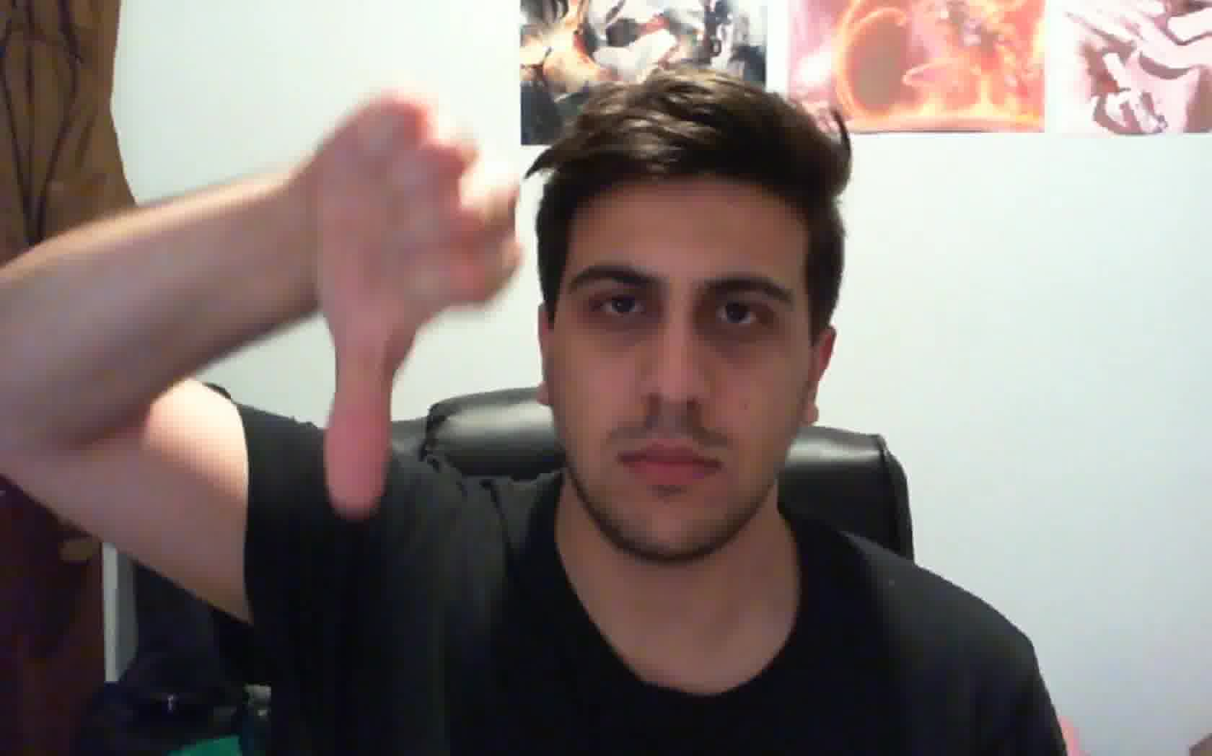
Gestures chosen
Stop Sign => Asking for a draw
Thumbs Up => Accepting draw
Thumbs Down => Declining draw

Slide 4
Initial Procedure
Script searchs “train – Cópia.csv” for Stop Sign, Thumbs Up and Thumbs Down video numbers
Copy all we find in our dataset to the video folder
Process with OpenPose to have json
Analyse individually with algorithm

Slide 5
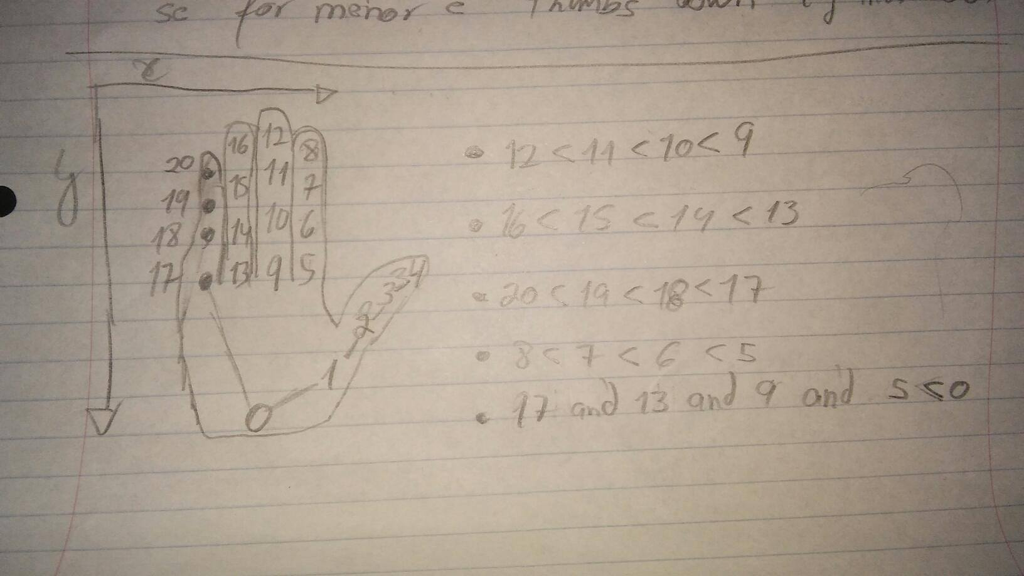
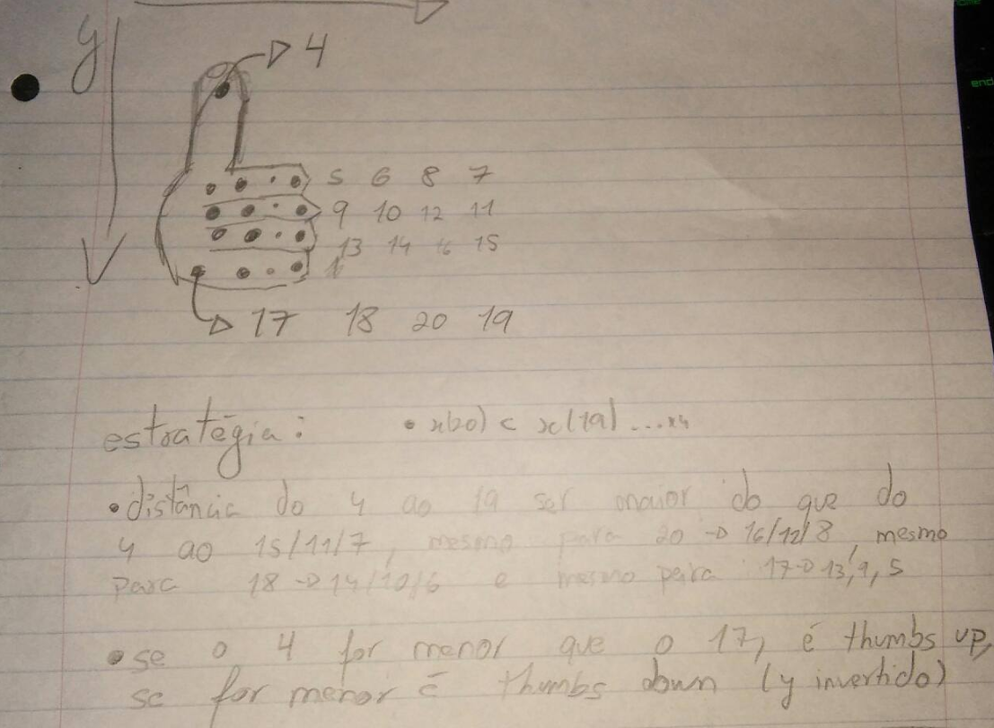
Algorithm

Slide 6



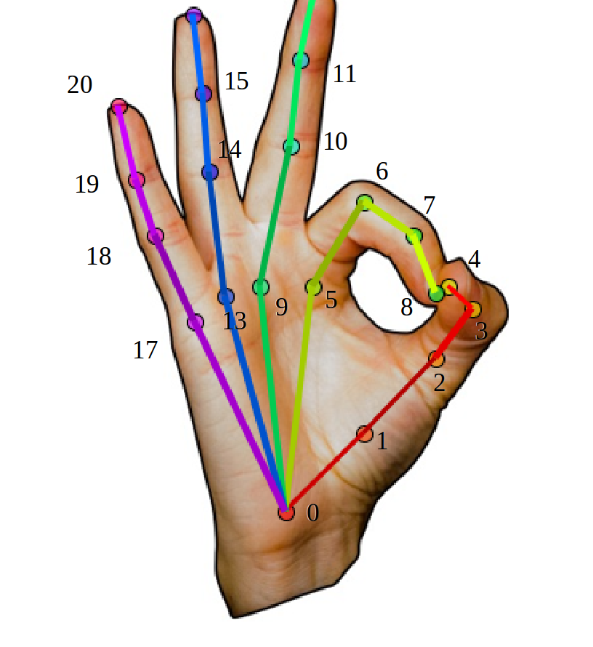
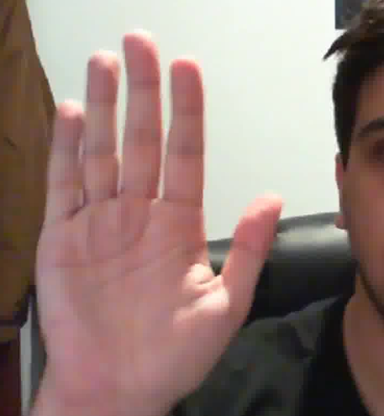
Algorithm
Strategic geometric questions Example: - all 5 fingers should be extended on stop sign - distance(p20,p0) > distance(p19,p0)

Slide 7
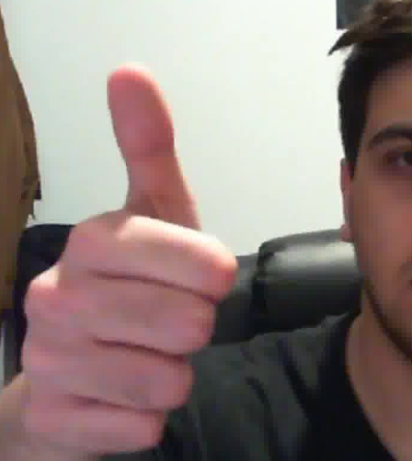
Algorithm
Strategic geometric questions Example: - each finger is lower than the previous in the y scale - distance(p20,p4) > distance(p19,p4)

Slide 8

Live usage
File name: 131493.json
Gesture to be identified: Stop Sign
Algorithm: This frame is a Thumbs Up
Algorithm: This frame is a Stop Sign
Algorithm: This frame is a Stop Sign
Algorithm: This frame is a Stop Sign
Algorithm: This frame is a Stop Sign
Algorithm: This frame is a Stop Sign
Algorithm: This frame is a Thumbs Down
Algorithm: The gesture identified is the Stop Sign

Slide 9
Final Display
There were 15 recognized in total but from the 10 Stop Sign showed there were 10 correctly identified (100.0%)
There were 13 recognized in total but from the 7 Thumbs Up showed there were 5 correctly identified (71.42857142857143%)
There were8 recognized in total but from the 15 Thumbs Down showed there were 4 correctly identified (26.666666666666668%)

Slide 10
Logistics
- Around 530 videos matched in our dataset
- After processed by OpenPose, 150 produced a json
- In those 150 jsons, only around 35 had useful information
- OpenPose couldn’t produce json from the self-recorded gestures

Slide 11
Future work
Enlarge the dataset
Improve on the thumbs up/down algorithm
Consider machine learning for the datasets
Implement our own gestures
Show images with the colored points displayed from OpenPose

